Slide 1

Name Of Cap
By:-
Harsheen Singh Saggoo
Aryan Yadav
Jay Adhana
Adesh Choudhary

Slide 2

Problem Statement
For a Visually Impaired person, Life is very tough. He faces a lot of problems in their daily life. He has a problem moving through roads, reading books, etc.
We are looking forward to providing Virtual Eyes and Companion for every visually impaired people.
With the help of our project, people will be independent and that will also boost their morale and end their disabilities

Slide 3
STATISTICS
According to WHO Globally, the number of people of all ages visually impaired is estimated to be 60 million and will be 100 million in the next decade.
In every 1 million --people 6 people are blind,35 people have low vision,40 people are visually impaired.
(Other facts are present in the form of a graph)
All the facts are taken from (https://www.who.int/blindness/GLOBALDATAFINALforweb.pdf?ua=1%3E)

Slide 4
Our Solution To The Problem
Through the help of AI, our team decided to work on a project which can become virtual eyes for a visually impaired person and also a companion for him.
So we come up with:
Name Of Cap

Slide 5
Hardware Info

Slide 6
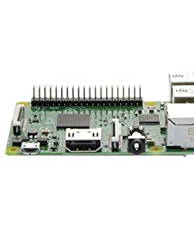
Raspberry Pi 3
This motherboard from Raspberry Pi features 4 USB ports, an HDMI port and a 3.5mm audio jack, among other features. It is built on the latest broadcom 2837 ARMv8 64bit processor. The motherboard also features a micro SD card slot. The micro SD card slot follows a push-pull technique. Install this motherboard in your computer for a fast and responsive system.

Slide 7
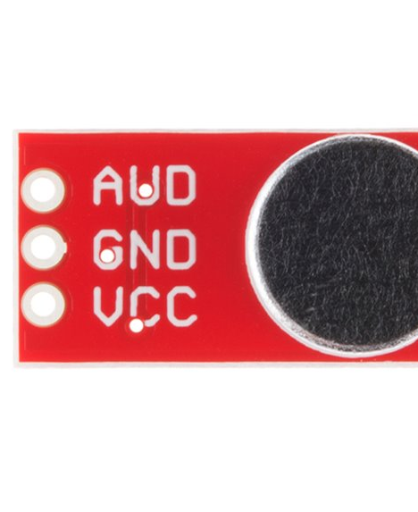
Spark Fun Electret Microphone
This small breakout board couples an Electret microphone (100Hz--10kHz) with a 60x mic preamplifier to amplify the sounds of voice, claps, door knocks or any sounds loud enough to be picked up by a microcontroller’s analog-to-digital converter. Each breakout comes fully assembled and works from 2.7V up to 5.5V.

Slide 8
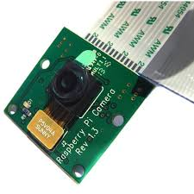
Raspberry Pi 5MP Camera Module with Cable
The 5MP Raspberry Pi 3 Model B Camera Module with Cable equips flexible cable for attaching with Raspberry Pi 3 Model B. The 5MP camera module is perfect for small Raspberry Pi projects which have very little space allowance just boot up the latest version of Raspbian and you are good to go!!!

Slide 9
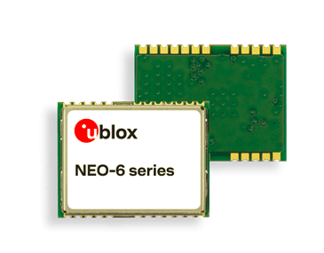
Neo 6M
The NEO-6 module series brings the high performance of the u-blox 6 position engine to the miniature NEO form factor. u-blox 6 has been designed with low power consumption and low costs in mind. Intelligent power management is a break- through for low-power applications. These receivers combine a high level of integration capability with flexible connectivity options in a small package. This makes them perfectly suited for mass-market end products with strict size and cost re- quirements. The DDC interface provides connectivity and en- ables synergies with u-blox LEON and LISA wireless modules.

Slide 10
Assistant
(operated by voice command)
CAMERA
(Real Time recording)
ULTRASONIC SENSOR
(Distance Between 2 objects)
CA
RASPBERRY PIE3
(Control Unit)
Voice Command
(Alerts user if object is close)

Slide 11
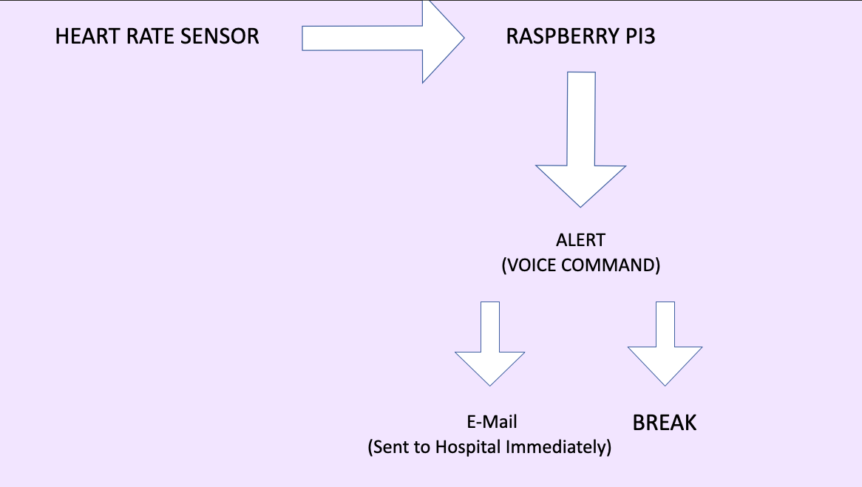

Slide 12
FUTURE ADD-ONS
Pre-Possesing
Natural Language Processing

Slide 13
COSTING
S.NO | MANE | PRICE
1. | RASPBERRY PI 5MP CAMERA MODULE WITH CABLE | 395
2. | RASPBERRY PI3 | 3000
3. | SPARKFUN ELECTRET MICROPHONE AUDIO | 150
4. | RASPBERRY PI CAMERA | 1000
5. | STICK | 300
6. | NEO 6M | 800
7. | HEARTBEAT SENSOR | 200

Slide 14
THANK YOU

